Slide 1


Brain-Computer Interface (BCI)
by - Somya Ranjan Kabi
Regd no – 2201229187
6th Sem
Sec – ‘C’

Slide 2
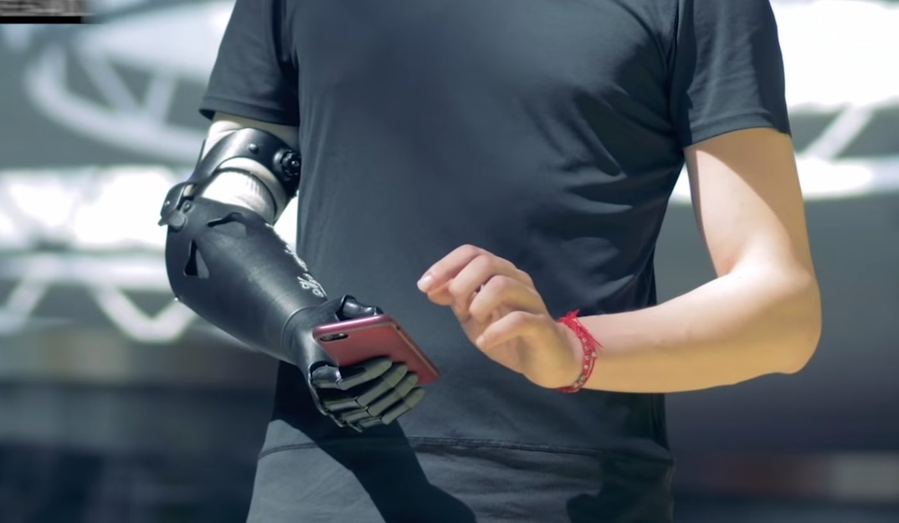
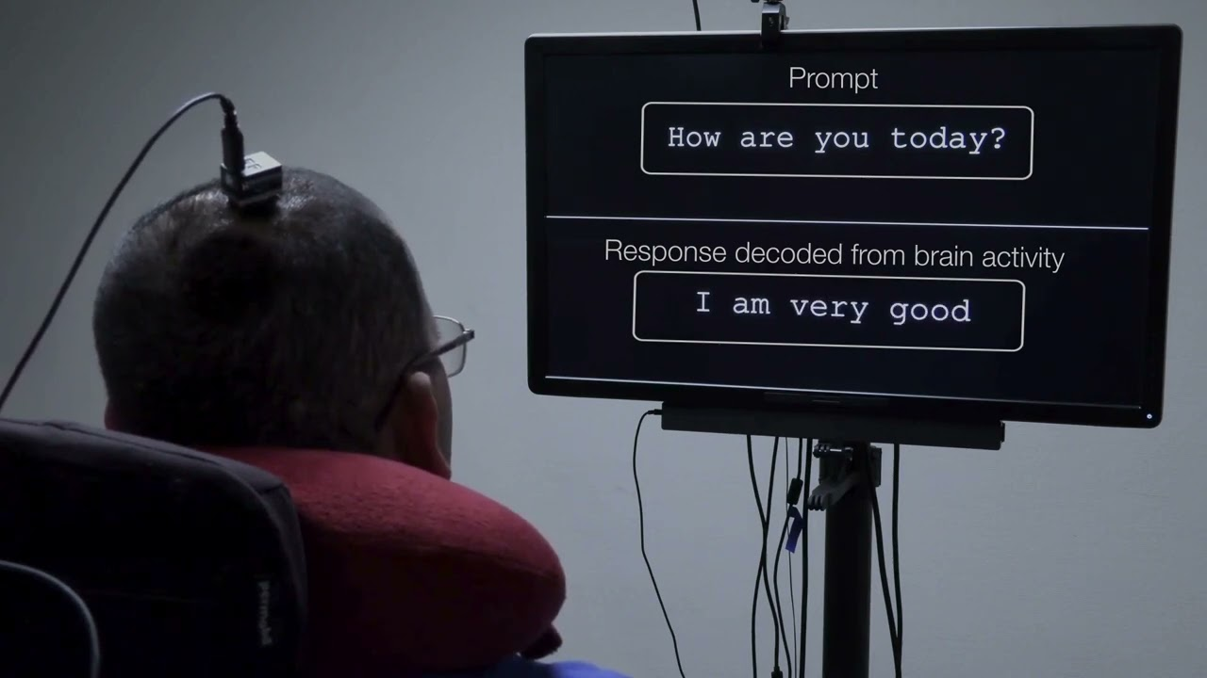

Introduction to Brain-Computer Interfaces
Definition
A BCI enables direct communication between the brain and external devices.
It translates neural activity into commands, allowing users to control computers, prosthetic limbs, or other devices using only their thoughts.
Purpose
Medical Applications:
Neuroprosthetics
Stroke Rehabilitation
Epilepsy & Neurological Disorders
Communication & Accessibility:
Brain-to-Text Systems
Smart Home Control
Human Augmentation & Future Tech
Brain-to-Brain Communication
AI Integration
Neural Implants

Slide 3

History of BCI Development
1
1970s
Early research focused on EEG-based communication methods.
2
1990s
Advancements in non-invasive and invasive BCI technologies emerged.
3
2000s-Present
AI integration, real-time applications, and commercial research accelerated (e.g., Neuralink).

Slide 4
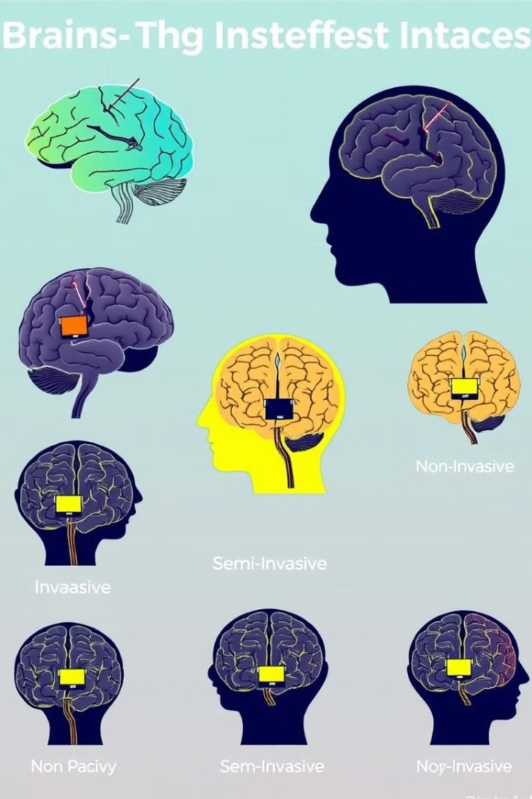
Types of Brain-Computer Interfaces
Invasive BCI
Semi-Invasive BCI
Non-Invasive BCI
Implanted directly into the brain tissue for high precision.
Placed inside the skull but outside the brain tissue.
Uses external devices like EEG caps; widely used in research.

Slide 5





How BCI Systems Work
Signal Acquisition
EEG, ECoG, fNIRS capture brain activity.
Preprocessing
Noise filtering and signal amplification.
Feature Extraction
Identifying relevant brain activity.
Classification
AI interprets signals, translates to commands.

Slide 6

Applications of BCI Technology
Medical Field
Neuroscience Research
Gaming & VR
Assisting paralyzed patients and stroke rehabilitation with neuroprosthetics.
Understanding brain functions and cognitive studies.
Brain-controlled video games and virtual reality experiences.

Slide 7




Challenges in Brain-Computer Interfaces
1
High Costs
2
Ethical Concerns
3
Computation
4
Low Signal
Significant obstacles remain: low signal quality from non-invasive methods, high computational demands for real-time processing, ethical issues related to privacy and data security, and the high cost of the technology that limits widespread use.

Slide 8
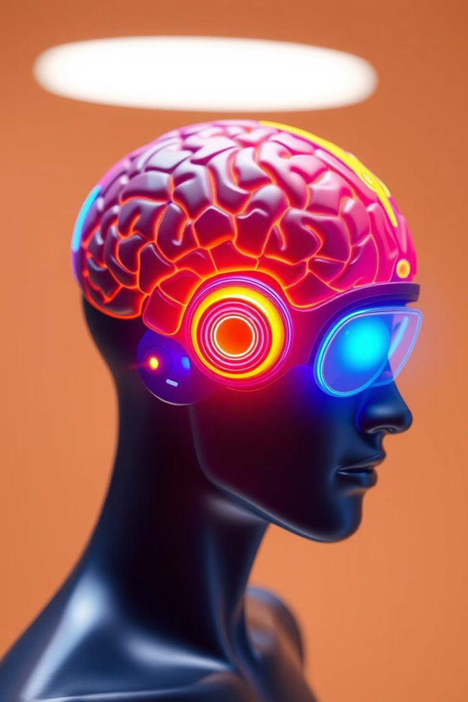
Future of Brain-Computer Interfaces
1
AI Integration
2
Miniaturization
Use AI and deep learning for enhanced accuracy.
Develop wireless BCI devices that are smaller.
3
Ethical Guidelines
Establish ethical and regulatory developments.

